Slide 1
Data Science
4 Week
1분기
ML Basic
8 Week
AI
Review
2 Week
2분기
ml-agents
10 Week

Slide 2
matplotlib
Data Science
numpy
ML Basic
pandas
Review
ml-agents

Slide 3
Data Science
Overview
1W
ML Basic
Regression
5W
Review
Clustering
2W
ml-agents

Slide 4
Data Science
Overview
각종 예시를 활용한 단어 설명 ex) 인공지능, 머신 러닝, 딥러닝 등
ML Basic
Regression
Review
Clustering
ml-agents

Slide 5
K-Nearest Neighbor
Data Science
Overview
Simple Linear Regression
ML Basic
Regression
Logistic Regression
Perceptron, Neural Network
Review
Clustering
Convolutional neural network
ml-agents

Slide 6
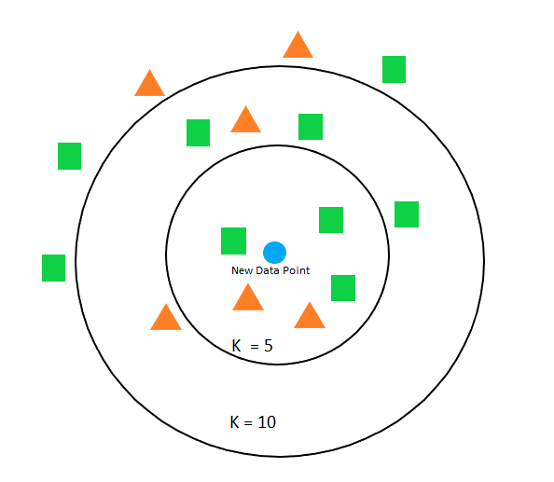
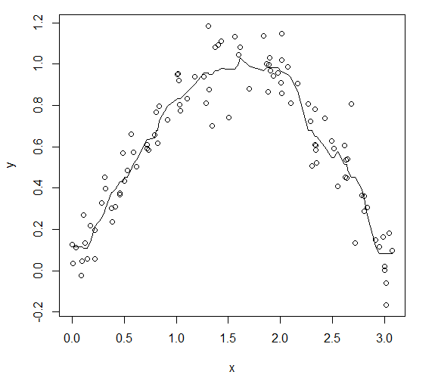
K-Nearest Neighbor
Simple Linear Regression
Logistic Regression
Perceptron, Neural Network
Convolutional neural network

Slide 7
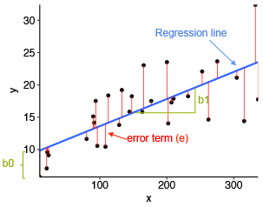
K-Nearest Neighbor
Simple Linear Regression
Logistic Regression
Perceptron, Neural Network
Convolutional neural network

Slide 8
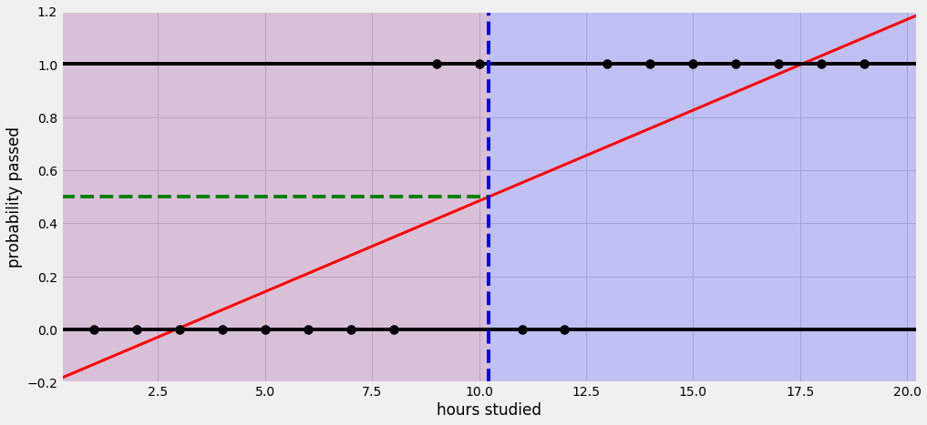
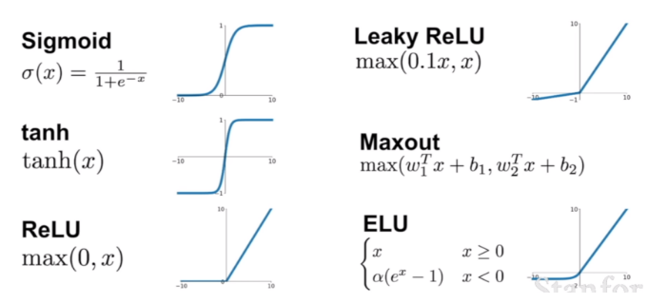
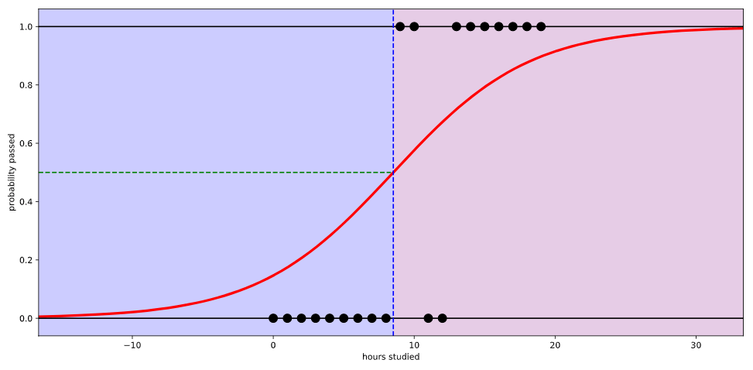
K-Nearest Neighbor
Simple Linear Regression
Logistic Regression
Perceptron, Neural Network
Convolutional neural network

Slide 9
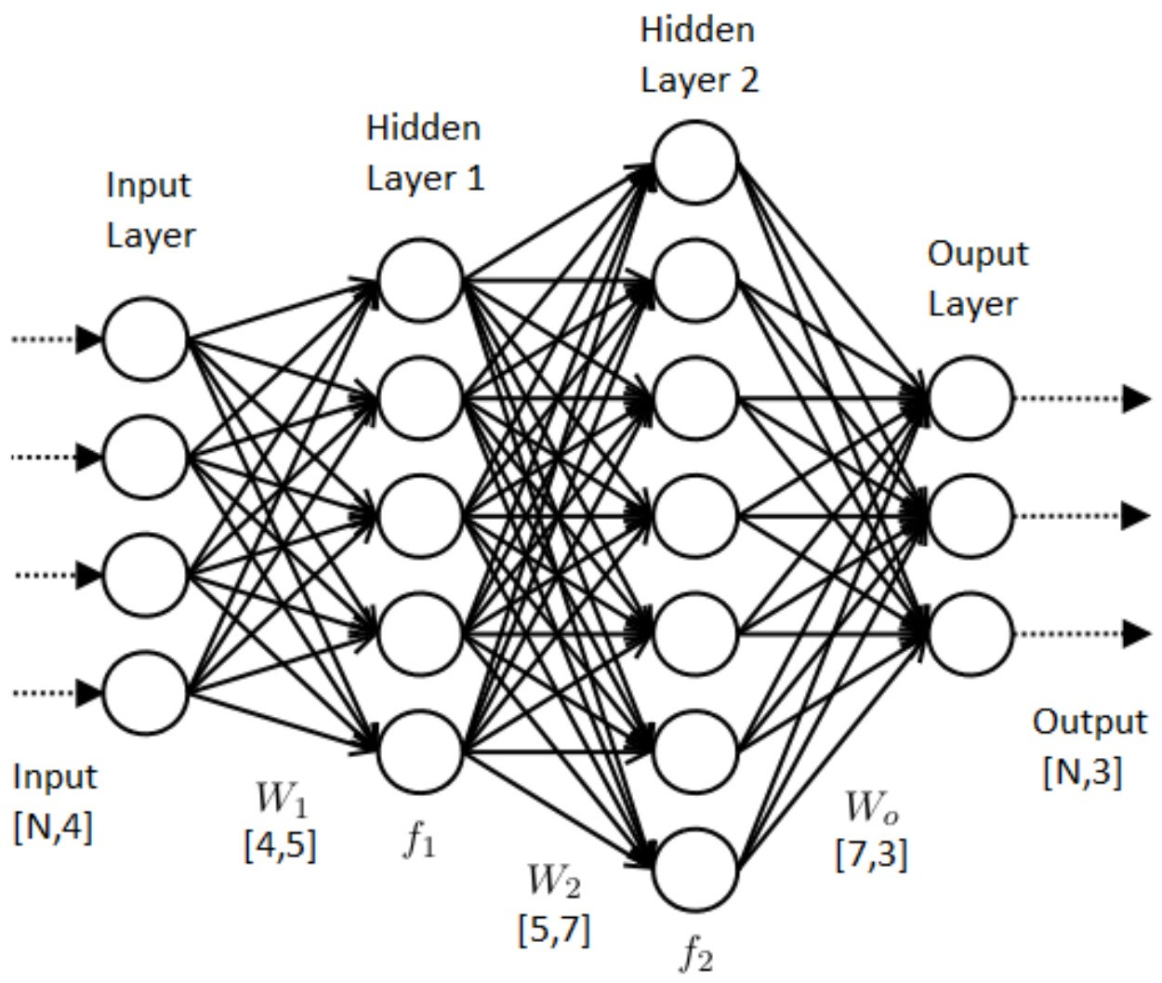
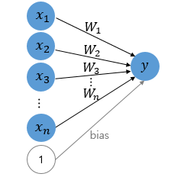
K-Nearest Neighbor
Simple Linear Regression
Logistic Regression
Perceptron, Neural Network
Multi Regression
Convolutional neural network

Slide 10
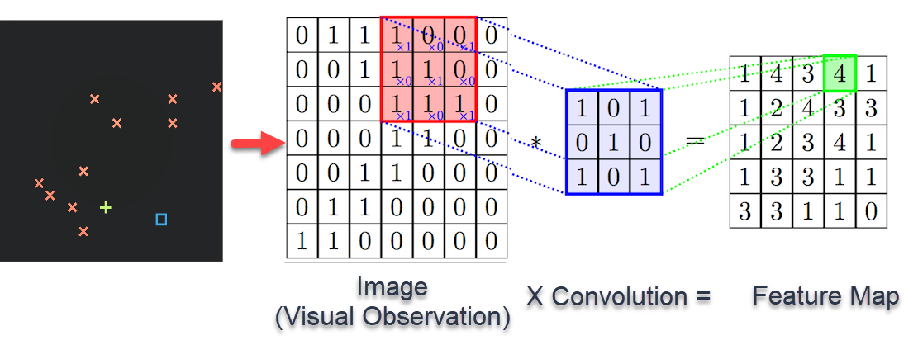
K-Nearest Neighbor
Simple Linear Regression
Logistic Regression
Perceptron, Neural Network
Convolutional neural network

Slide 11
Data Science
Overview
K-Means Clustering
ML Basic
Regression
PCA
Review
Clustering
ml-agents

Slide 12
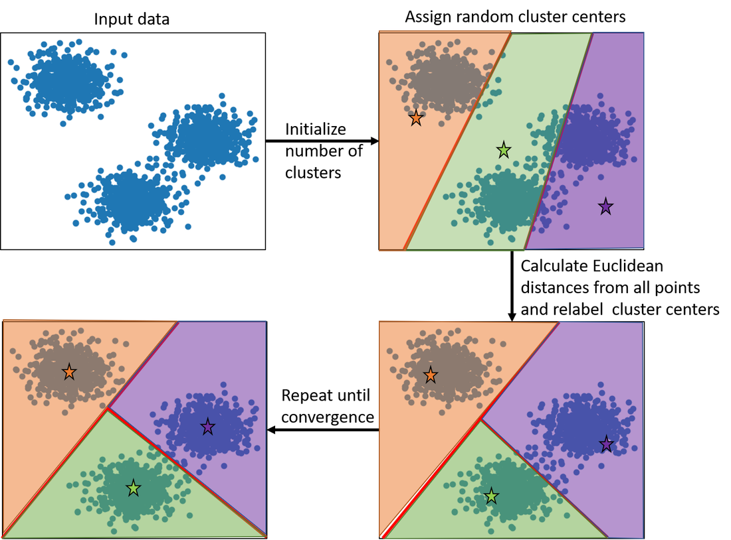
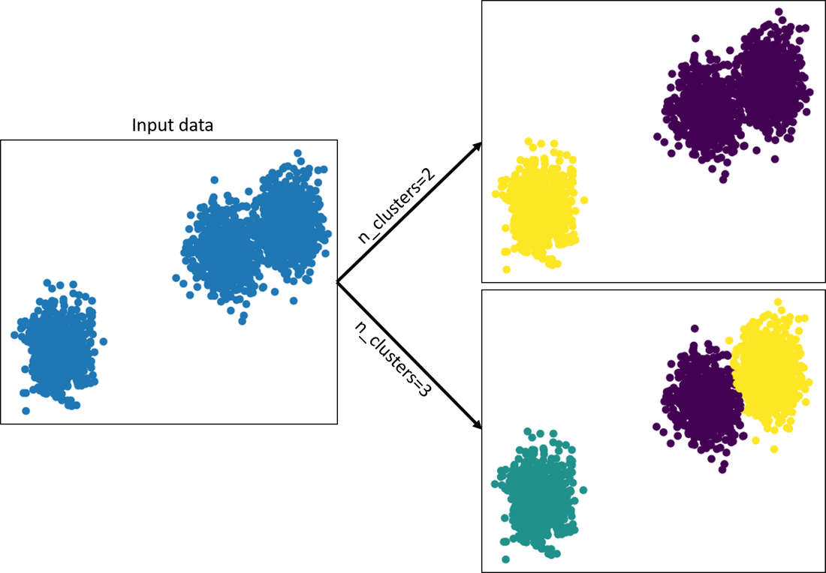
K-Means Clustering
PCA

Slide 13
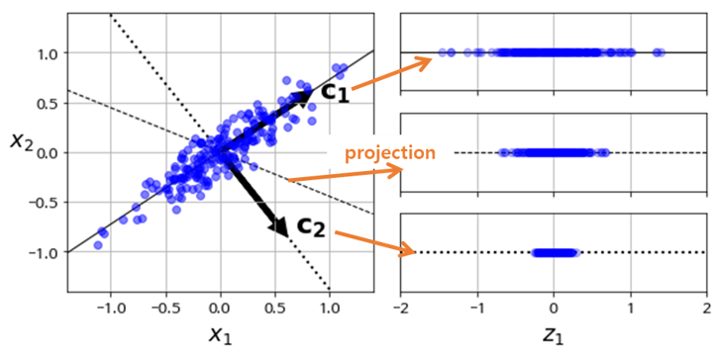
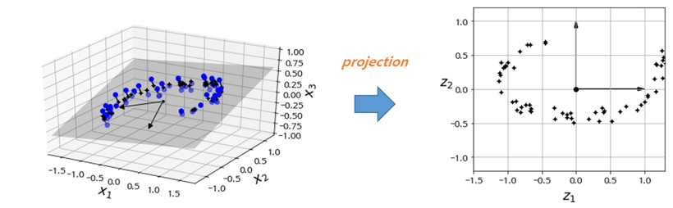
K-Means Clustering
PCA

Slide 14
Data Science
ML Basic
Review
2W 1분기 내용 Review
ml-agents

Slide 15
Reinforcement
Overview
Data Science
One Dimension Movement
2 Week
ML Basic
Multi Dimension Movement
2 Week
GridWorld
Q function, epsilon, lambd
Review
2 Week
Ray Observation
ml-agents
EX Project

